Slide 1
Women’s Philanthropy: 20 Years of Gender and Giving Trends
February 20, 2025
Facilitated by Angela Seaworth, Ph.D.
Jacqueline Ackerman, MPA

Slide 2
Center Overview
CNP supports a vibrant nonprofit and philanthropic sector in Texas and beyond, through high quality research, professional outreach and engaged learning.

Slide 3
Upcoming Events
March 6, 2025: Leadership in Board Service
Annenberg Presidential Conference Center from 4:00 – 7:00 pm
March 19, 2025: March Webinar
Zoom Noon - 1:00
April 10, 2025: April Webinar about leadership and the power of transformation
Zoom Noon - 1:00
May 13, 2025: Unlocking System Thinking: Tools for Transformation
Zoom from 1:00 - 4:00 pm
Scan to Register!

Slide 4
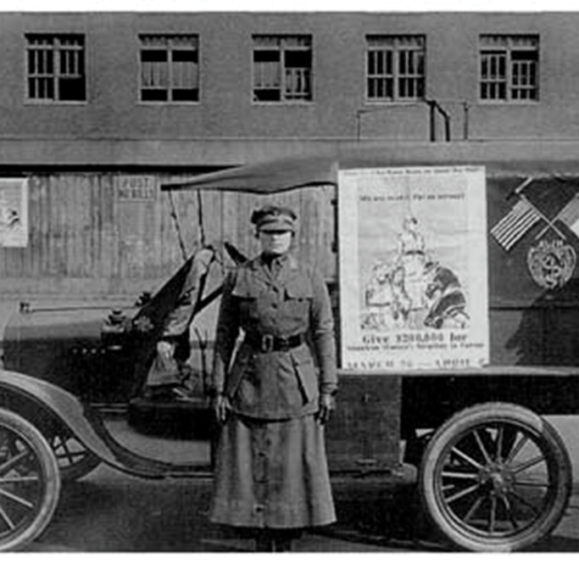
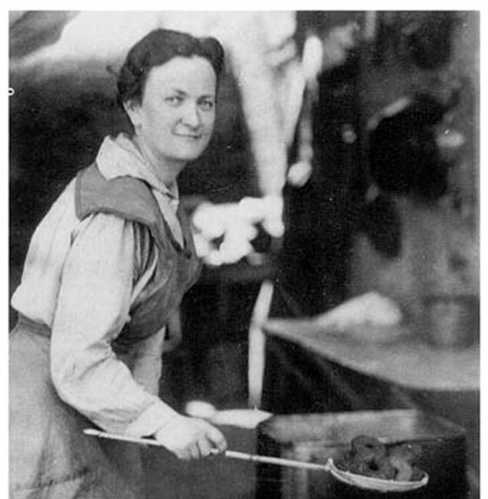
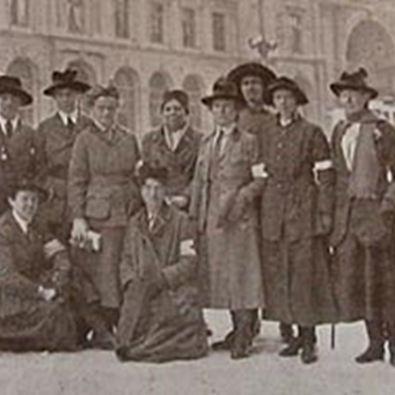
“Women are beginning to lead in philanthropy.”
WHAT?!? Yes, they began leading in philanthropy centuries ago.
Or, according to historian Kathleen McCarthy (2003), women in 1797 “helped lay the groundwork for a parallel female empire of philanthropy to complement the growing variety of male-controlled institutions forged by men like Benjamin Franklin and Divie Bethune.” (pg 33)
Notes:
McCarthy writes about parallel power structures

Slide 5
Women in Philanthropy
Elizabeth Ann Bayley Seton 1774-1821
Bernice Pauahi Paki Bishop 1831-1883
Josephine Shaw Lowell 1843-1905
Jane Addams 1860-1935
Madam C.J. Walker 1867-1919
Dolores Huerta 1930-present
Marie Curie 1867-1934
Joanne Bethune 1770-1860
Mary Lyon 1797-1849
Rebecca Gratz 1781-1869
Dorothea Lynde Dix 1802-1887
Helen Maria Hunt Jackson 1830-1885
Frances Elizabeth Caroline Willard 1839-1898
Dorothy Day 1897-1980
Ida B. Wells-Barnett
1862-1932
Elsie Inglis 1864-1917
“These women and too many others to begin to name were creative and took advantage of chaotic conditions and lack of coordination to expand their scope and form new organizations that allowed them to influence society. “

Slide 6
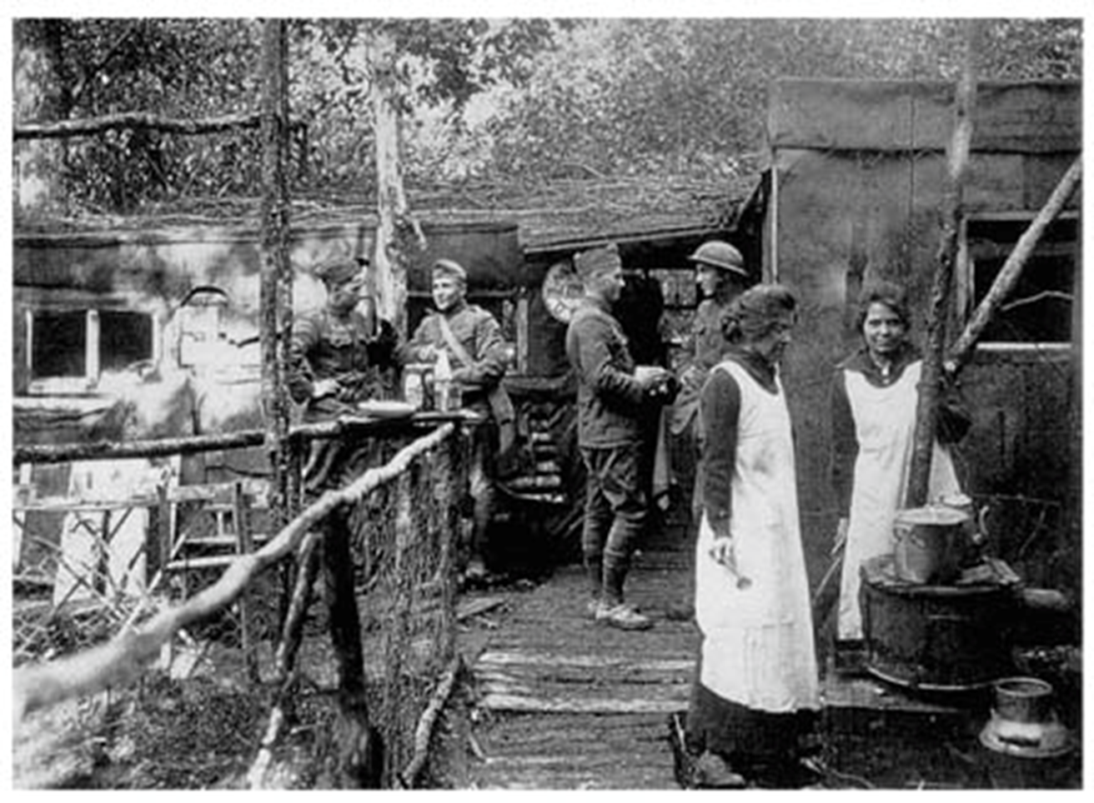
How are today’s women leading in philanthropy?
“Despite facing many obstacles involving gender limitations of the time, these women were determined to make a difference, and their ingenuity enabled them to succeed.”
Women made social progress, developed leadership skills in new arenas, and as Eva Perry Moore wrote in 1919, “Women have proved their worth in new fields of activity; they have developed unknown qualities of leadership and management that will not be allowed to lie dormant.”
Notes:
Tremendous history of women in philanthropy, so…how are today’s women leading in philanthropy? That is why we have invited a terrific speaker to share research how women are giving today.

Slide 7
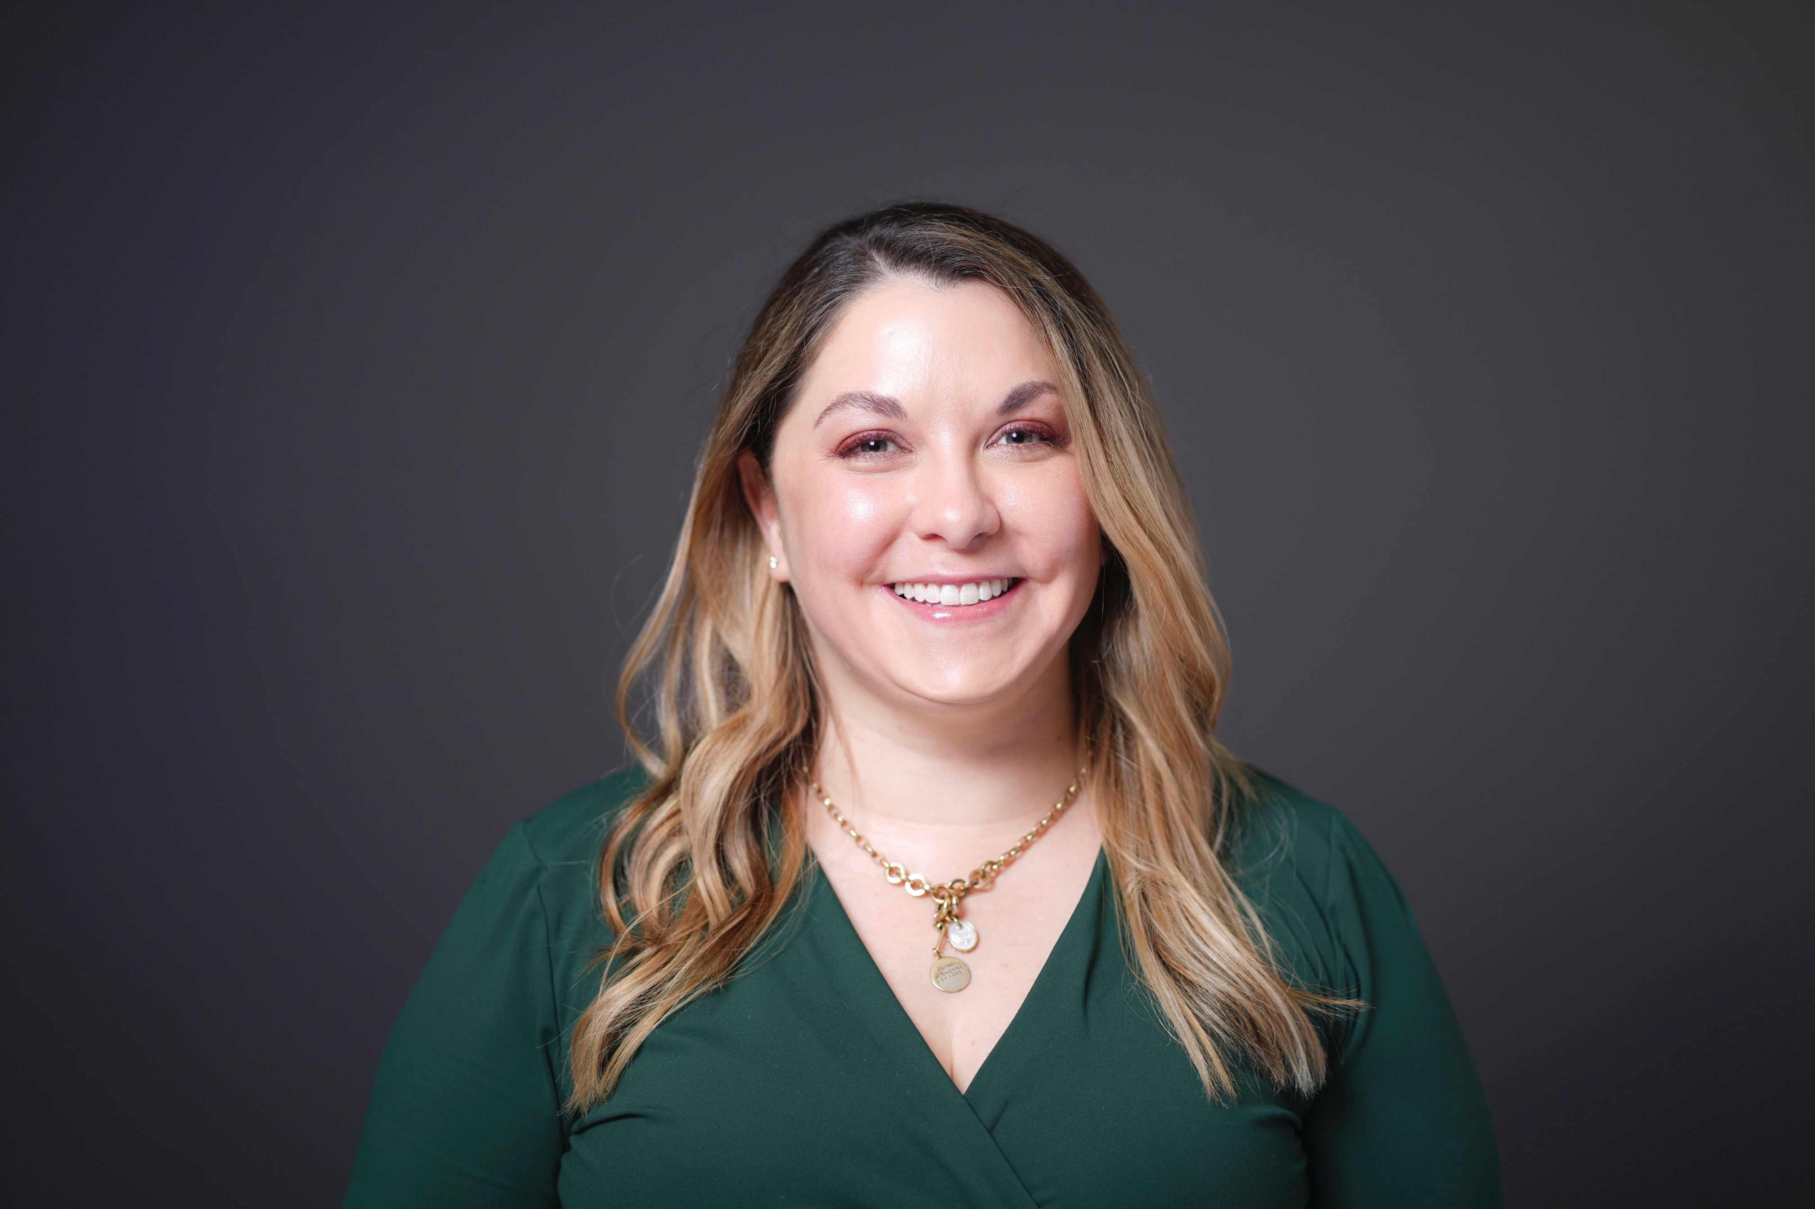
Our Speaker
Jacqueline Ackerman, MPA - is Interim Director of the Women’s Philanthropy Institute (WPI) at the Indiana University Lilly Family School of Philanthropy. WPI believes that gender matters in philanthropy, and that solving the world’s complex problems requires perspective, leadership and generosity from women and men. Jacqueline’s work centers on moving the institute’s research into action, delivering insights to donors, fundraisers and sector leaders that grow women’s giving and deepen fundraisers’ engagements with female donors. Over the last decade, Jacqueline has led WPI’s research agenda, including serving as primary author on most of WPI’s research reports. Jacqueline joined the Lilly Family School of Philanthropy in 2012 after earning a Master of Public Affairs from the Indiana University O’Neill School of Public and Environmental Affairs in Bloomington. She was raised in Port-au-Prince, Haiti, and resides in Bethesda, MD.

Slide 9
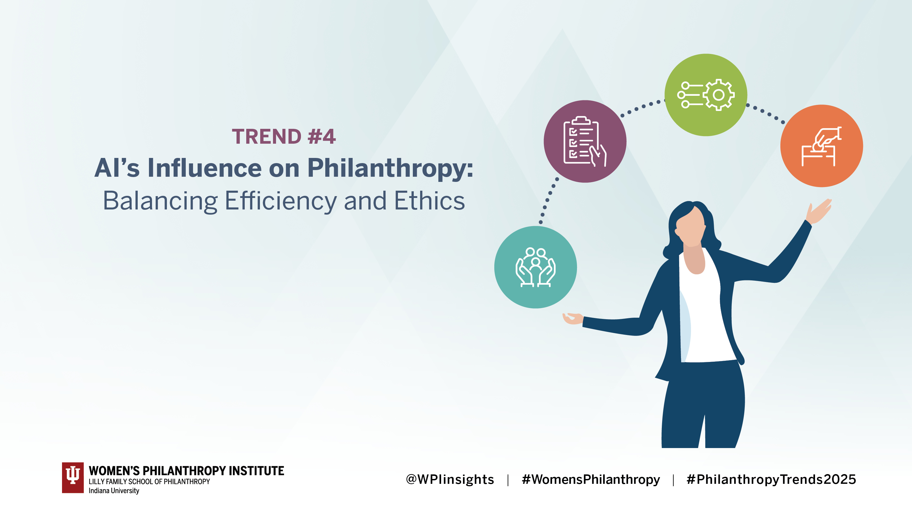
Introductions
Indiana University Lilly Family School of Philanthropy
Academic programs
The Fund Raising School (TFRS)
Research
Institutes
Women’s Philanthropy Institute
Lake Institute on Faith and Giving
Mays Family Institute on Diverse Philanthropy

Slide 10
Women’s wealth is rising.
Women’s share of wealth has risen considerably over the past 40 years, and today women hold around 40% of global wealth.
Women give more.
Across income levels and generations, women are more likely to give, and give more, than their male counterparts.
Women give differently.
From motivations to causes to behavior, women and men demonstrate different giving patterns.
The case for focusing on women donors

Slide 11
Across generations and racial groups, women are more likely than men to give.
Younger women influence household charitable decisions more than their older counterparts.
Women give nearly two-thirds of gifts on social and online platforms.
Research: Who gives?

Slide 12
Women drive charitable decision-making

Slide 13
How do women give?
Women give broadly
Women give collectively
Women give holistically

Slide 15
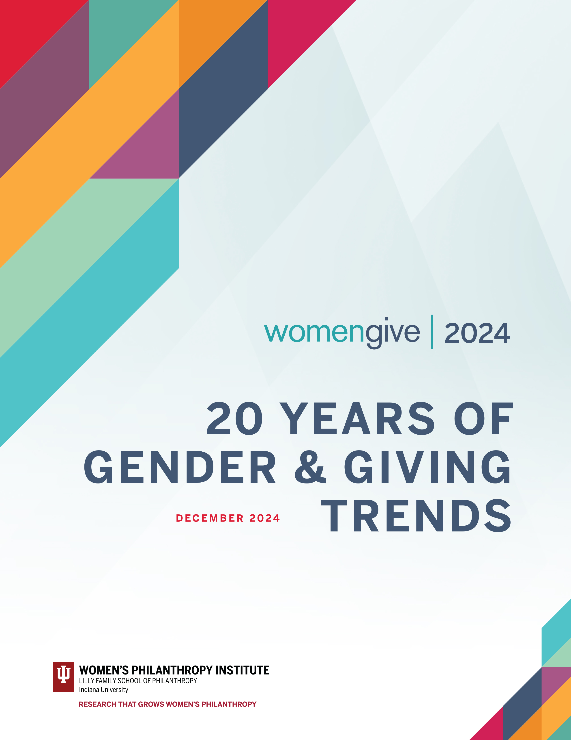
Newest research: Women Give 2024
How has giving by women and men changed over the last 20 years, especially in response to COVID-19?
Giving rates and amounts
“Donors down, dollars up”
Focus on COVID-19 and effect on women’s giving

Slide 16
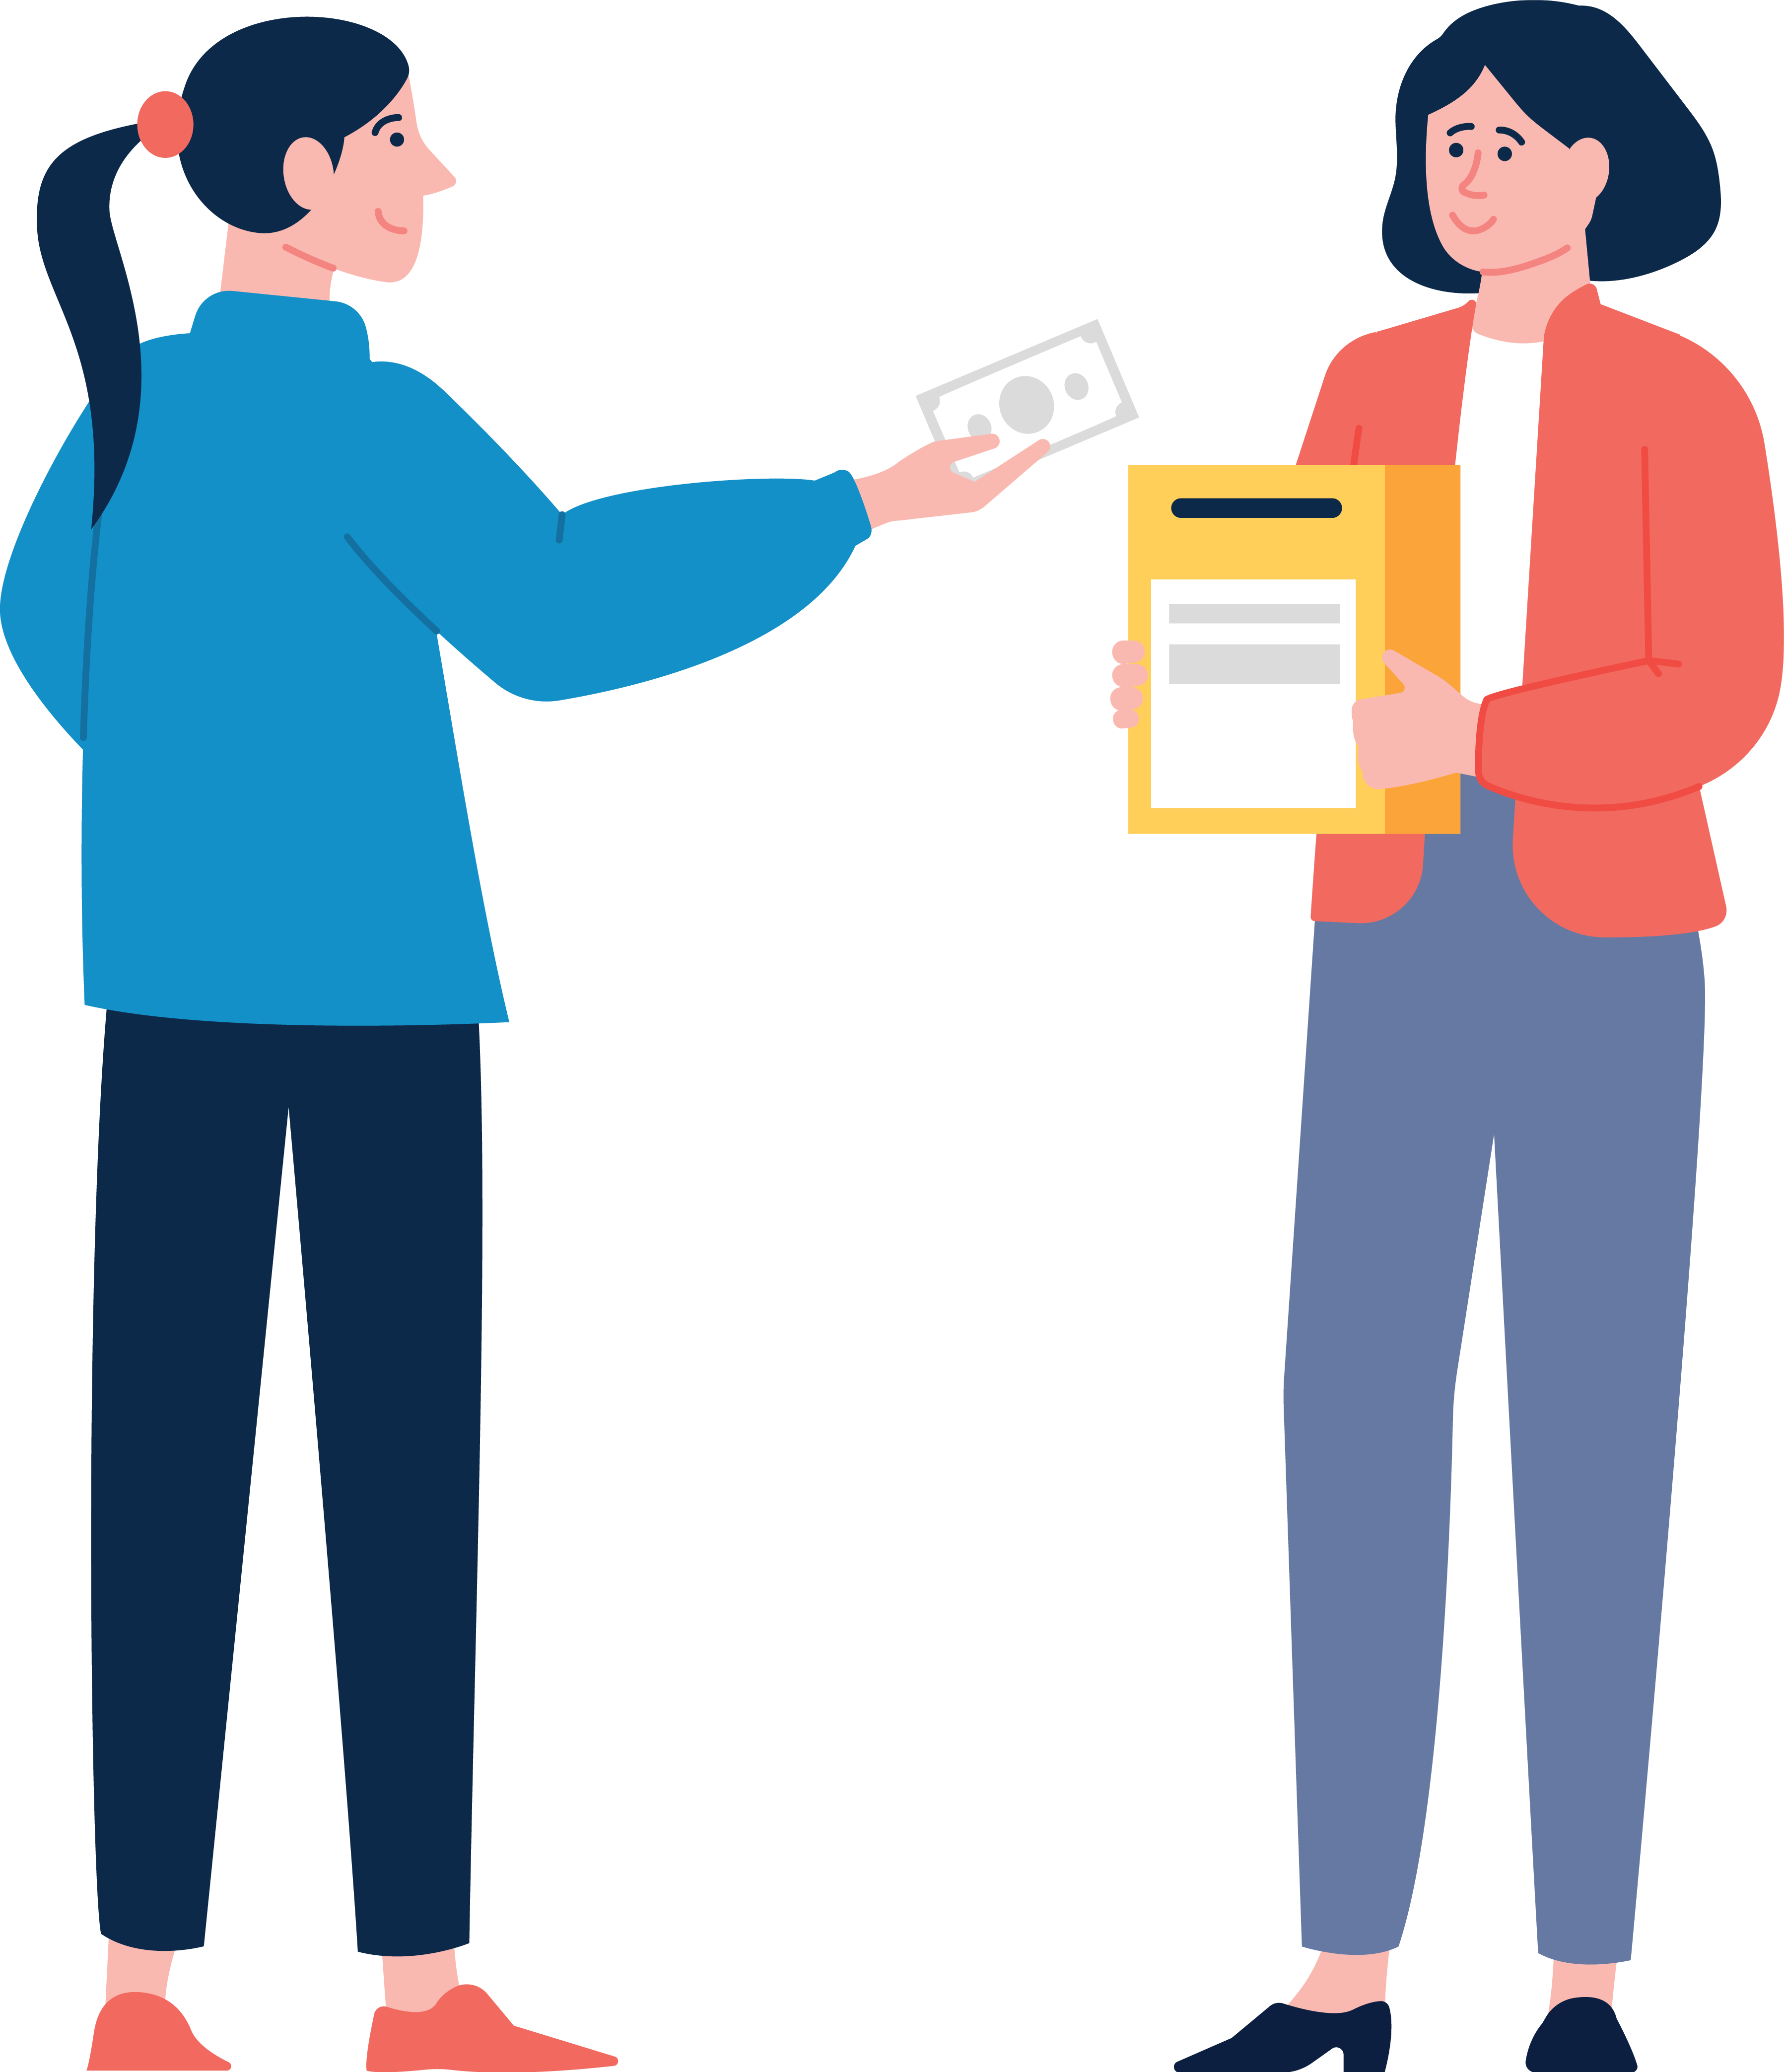
While the “donors down, dollars up” phenomenon has affected all household types, women stand out for their resilience.
U.S. households that donate to charity declined from 2000-2020.
However, the decline started later and was less pronounced for single women than single men.

Slide 18
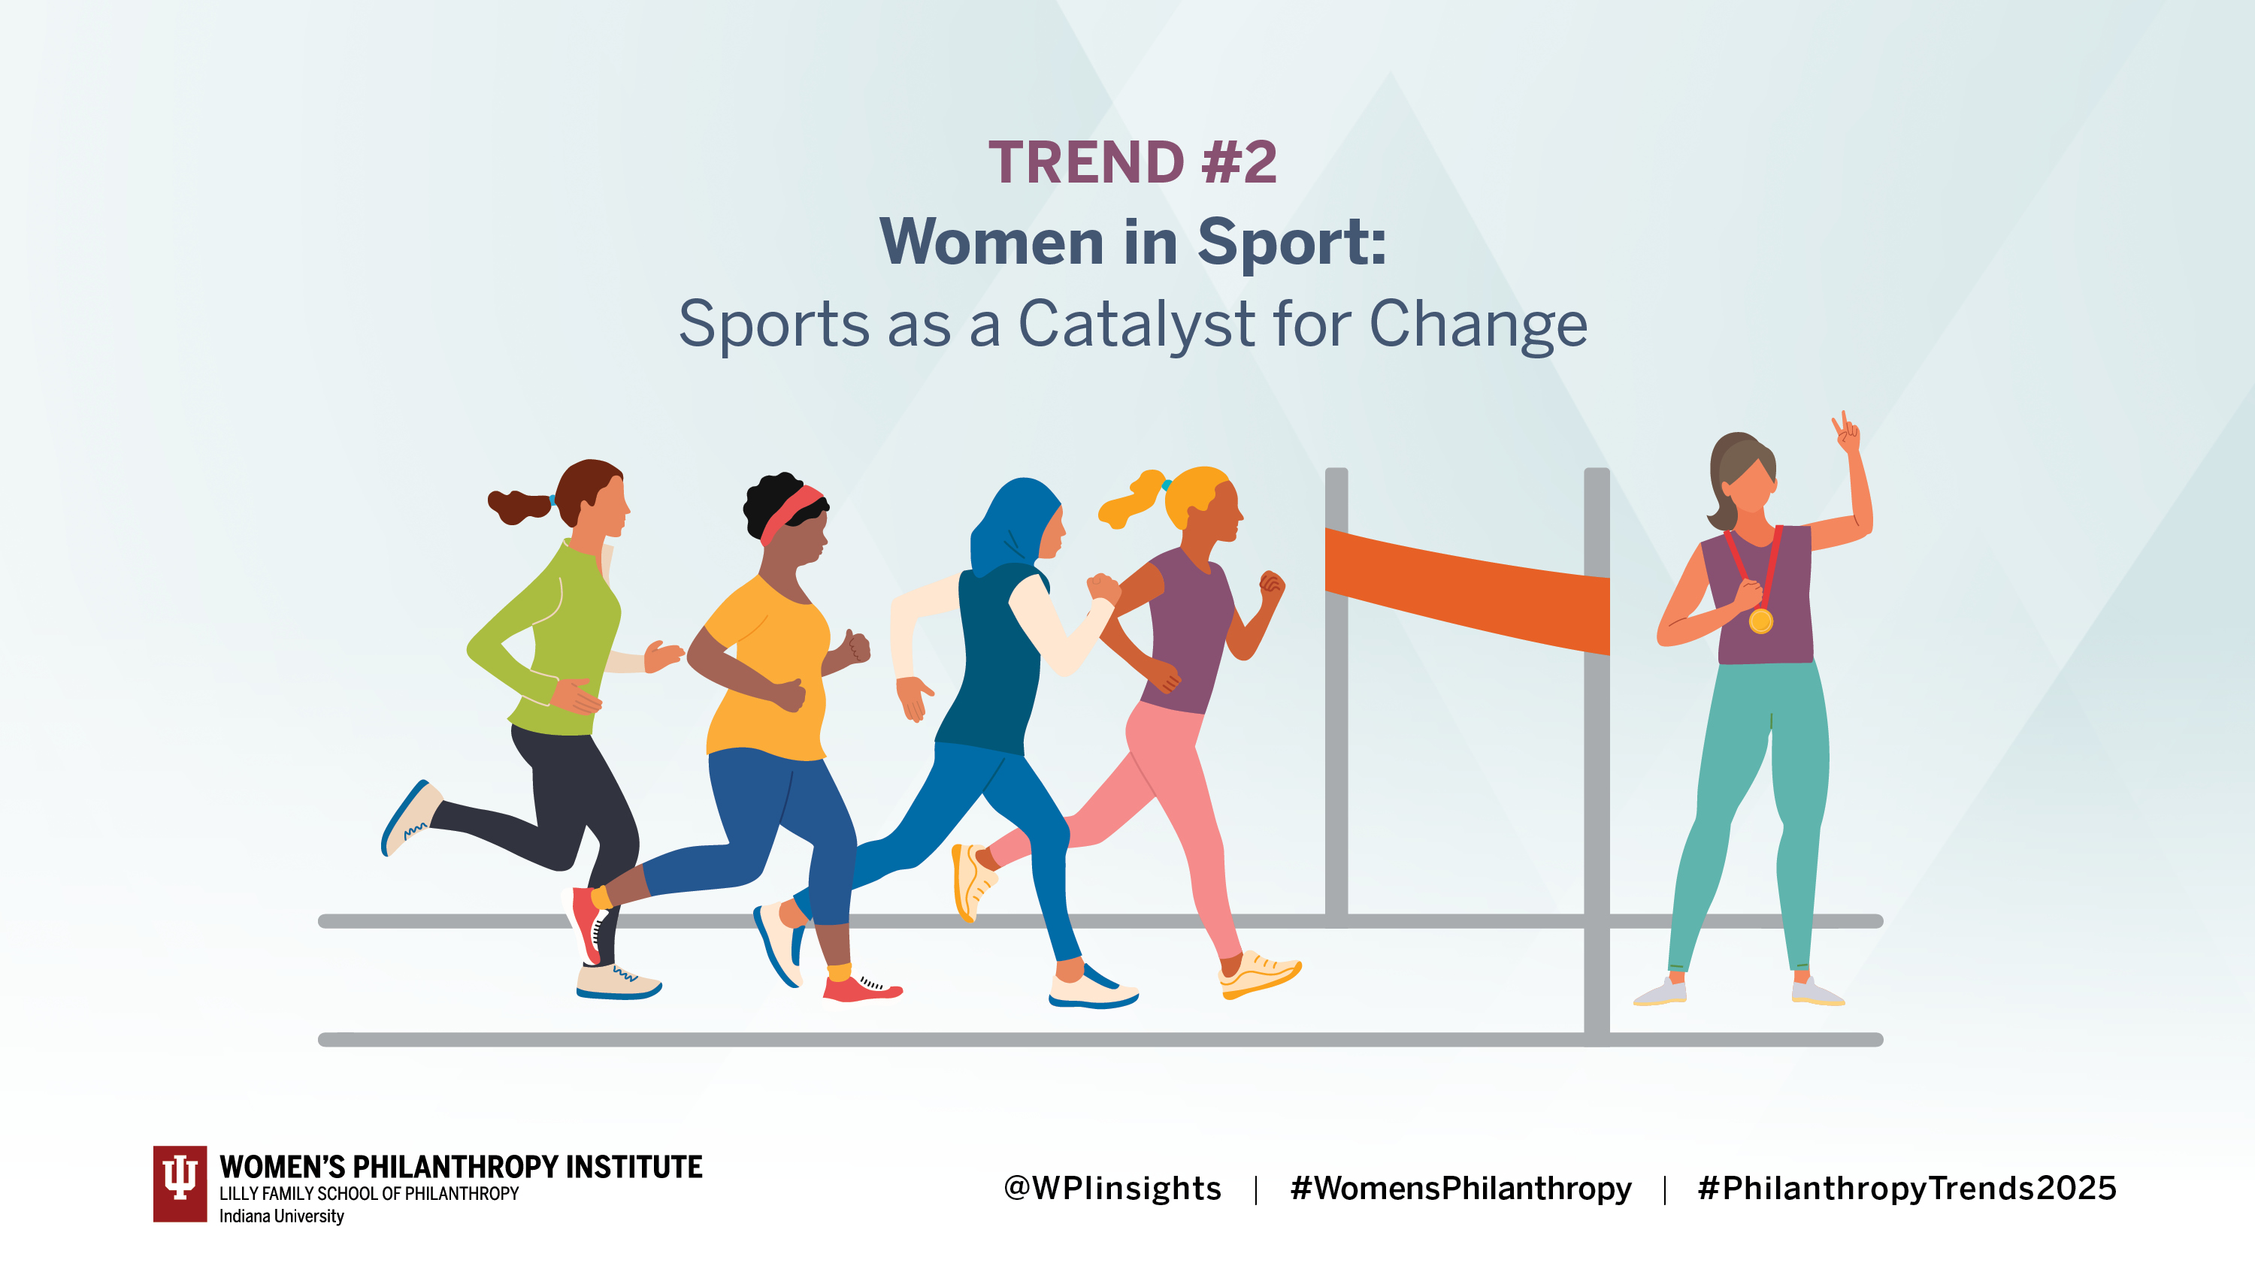

Slide 22
Women make an impact collectively
Two-thirds of donations on #GivingTuesday come from women
Around 70% of giving circles are majority-women

Slide 23
Today’s mega-donors
MacKenzie Scott
Melinda French Gates
Ruth Gottesman

Slide 24
Women’s Philanthropy: The 7 T’s
Time
Talent
Treasure
Testimony
Ties
Trust
Transparency

Slide 25
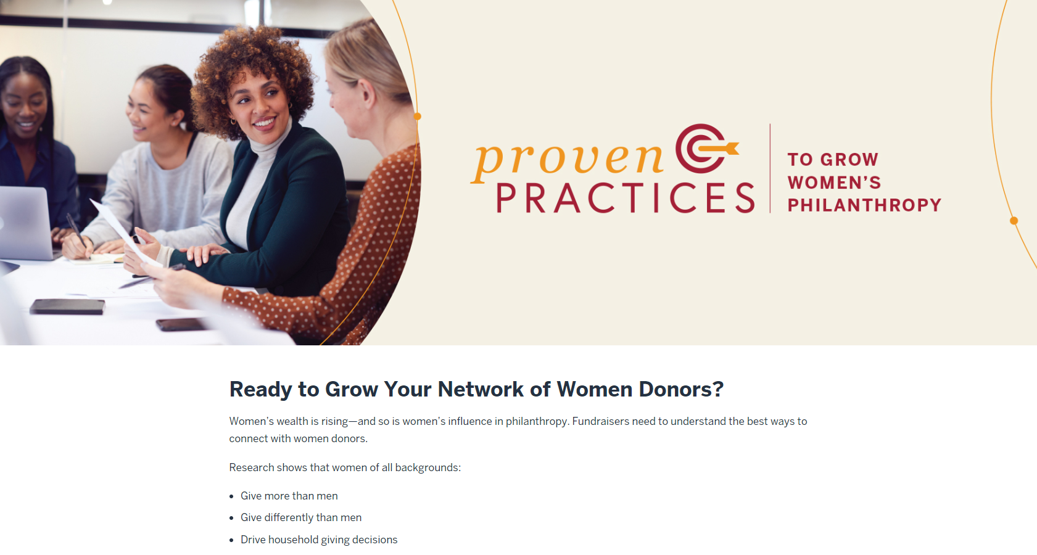
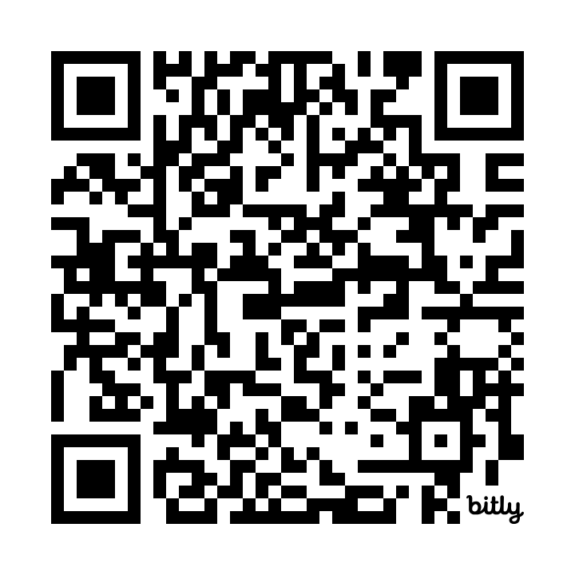

Slide 26
Stay in touch with WPI
philanthropy.indianapolis.iu.edu/WPI
/WomensPhilanthropyInstitute
/WomensPhilanthropy
@WPIinsights
/WomensPhilanthropy

Slide 27
Take Aways for Fundraisers
Analyze your donor base
Do you know what percentage of you donors are women?
How many women are volunteering for you?
Do you have incomplete records with empty fields in the spouse category?
Are you entering the primary donor correctly? For example, check to make sure thank you letters are addressed to the donor with the closest relationship to the organization.
Evaluate your case statement
Does your organization’s case statement demonstrate your organization’s relevancy in a way that appeals to women donors?
How do you explain impact?
Make giving easy
Be intentional about cultivating women donors.
How many women are in leadership volunteer roles or serving on your board?
Do you have opportunities to create a women’s giving circle?
Can women access your online giving easily?

Slide 28
Connect With Us!

