Slide 1
Political Influence and Donor Motivation During an Election Cycle
September 12, 2024
Facilitated by Angela Seaworth, Ph.D.
Ruth K. Hansen, Ph.D.
Mary Ridenour, MPSA

Slide 2
Center Overview
CNP supports a vibrant nonprofit and philanthropic sector in Texas and beyond, through high quality research, professional outreach and engaged learning.

Slide 3
Social Identities & Donor Motivation Research
Self
Religion
Civic/Political Organizations
Education
Family
Profession
Donors identify with various social identities – which means they develop their identity by interaction with society; therefore, they may behave differently based on:
your organization’s mission and role in the local ecosystem
the role they hold in your organization,
people they engage who are affiliated with your organization
In Achieving Fundraising Excellence, Dr. Timothy Seiler provide a wheel of roles and responsibilities that help determine donor behaviors. He also notes these roles will change over time. In my experience working with donors, roles and motives are fluid.
Fundraisers must understand that donors have mixed motives, that they are influenced by internal and external factors, and will respond differently in different contexts.

Slide 4
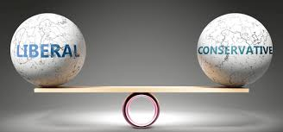
Social Identities in a Political Environment
Social Identities Influence how we market to different audiences
For example, to promote the environment we may promote environmental protection and keeping a green community for your children/grandchildren while promoting environmental preservation to appeal to older or more conservative donors
Dr. Hansen will share some of her research that indicates how people who identify with liberal tendencies or conservative tendencies are motivated.
Altruism
Egoism

Slide 5
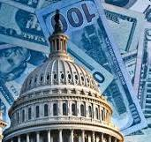
Political Fundraising
Political Fundraising is different from traditional, professional fundraising
Regulations restrict fundraising involvement, but consultants and PACs help fill that role
Motivation is tied to impact – top donors care about close margin races
It is more transactional
Trust in leadership influence in donor decisions
Maintaining or losing control of House or Senate
Contingency plans and fear can drive giving
Partisanship vs. Problem Solving
National major donors can be individual or corporations
Motivations between these constituents are very different:
Corporations motivated by self interest (where they do business)
Individuals are more issue focused and social issues will attract them to candidates

Slide 6
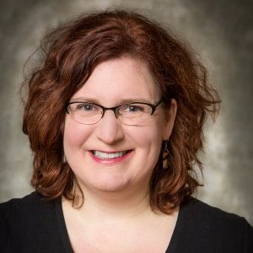
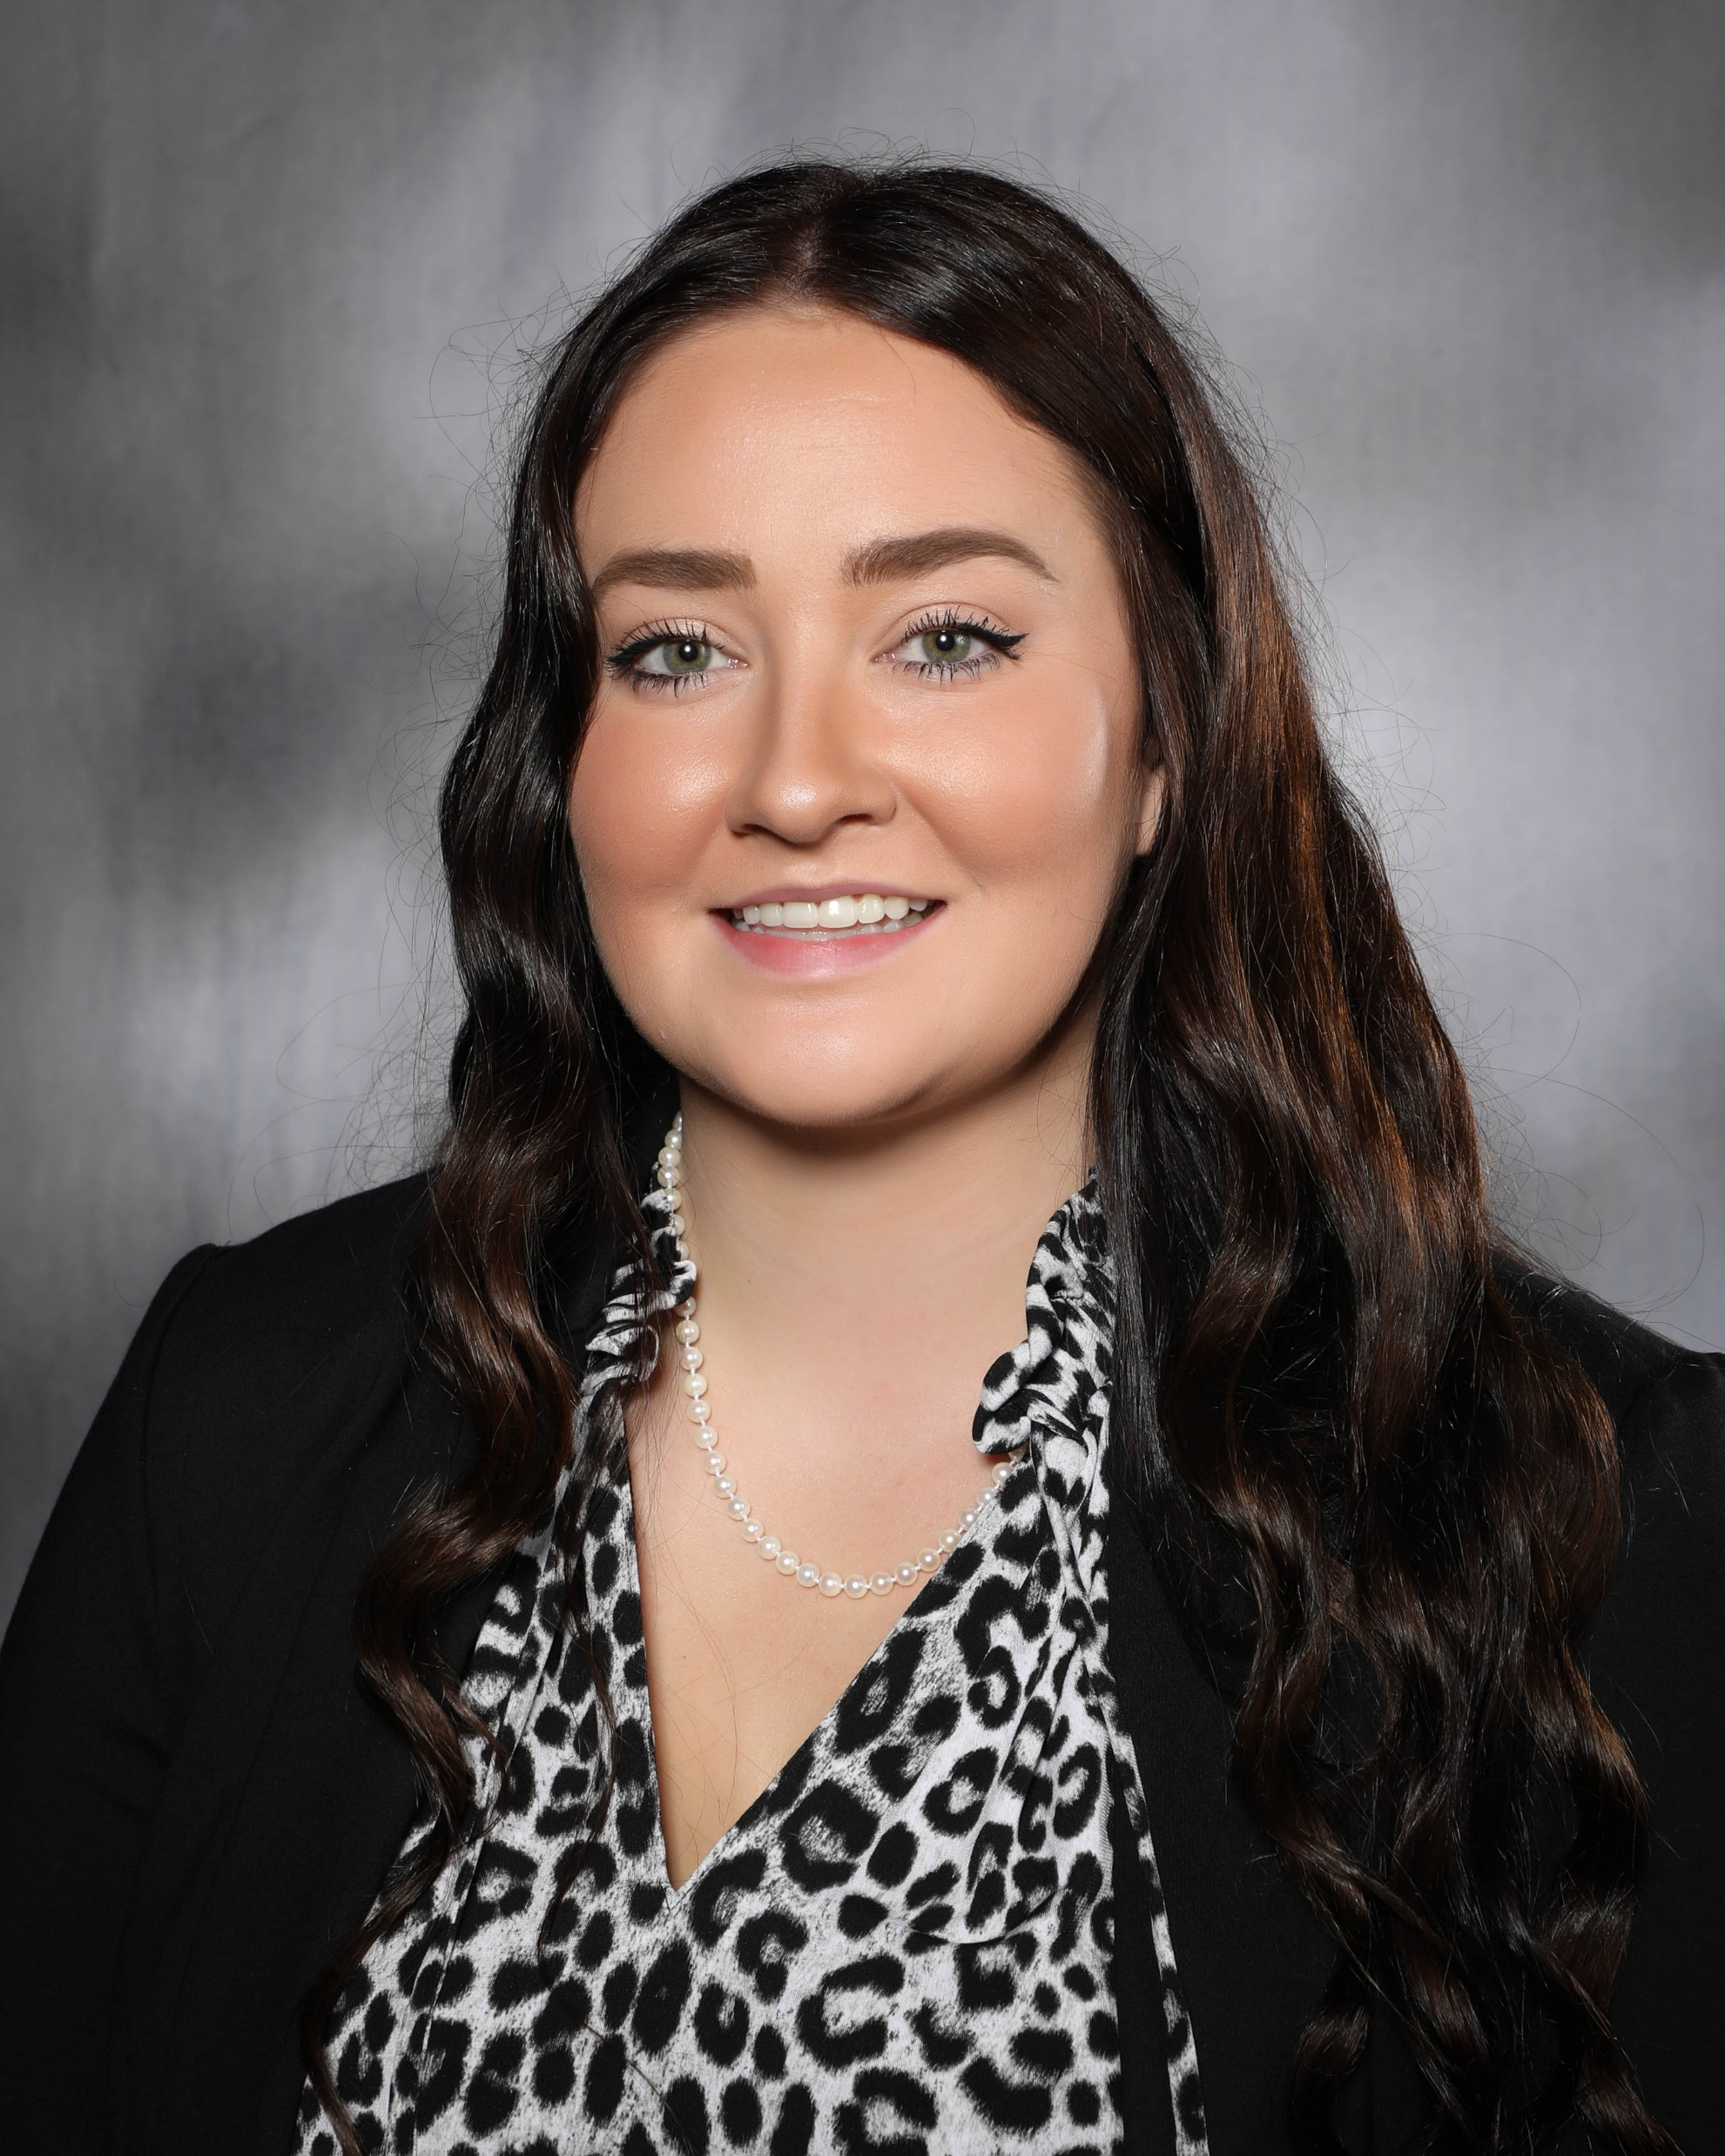
Our Speakers
Ruth K. Hansen, Ph. D. is an associate professor at University of Wisconsin-Whitewater’s College of Business and Economics, and director of the Institute for Nonprofit Management Studies. She teaches classes in nonprofit organizations, fundraising, organizational behavior, and research methods. Her research focuses on the theory & practice of fundraising, and equity and inclusion in resource mobilization. Dr. Hansen has more than 20 years’ professional experience as a fundraiser and is a former board member of AFP-Chicago.
Some of her recent publications explore how social values determine unmet needs, impulse giving decisions at the checkout, and ways to reframe fundraising research. She is an AFP Early Career Emerging Scholar, and has been awarded research funding from the AFP Foundation.
Mary Ridenour, MPSA joined The Morning Group in June 2023. She began her career as a Stewardship Student Assistant for The Association of Former Students at Texas A&M University. She then interned with the Heritage Foundation providing support to the Development Operations team.
Mary attended Texas A&M University, where she earned her Master of Public Service and Administration in 2023. She also attended the University of Wyoming, earning her bachelor’s degree in International Studies. Mary was raised in Yoder, Wyoming before moving to Washington, DC.

Slide 7
Take Aways for Fundraisers
The political world is very fickle – what happens in Washington changes all the time
Nonprofit advantage is not having to respond to what is happening in Washington. Keep doing the good work you are doing and promoting you missions. Remaining rooted in your mission offers stability and there are people who care about your good work, regardless of their social identity.
Mistake to assume all donors to an organization share the same beliefs or to assume that donors have the same motivations and political leanings as the staff. They may not agree with donor values or political motivation, focus on the good work and mission of your organization.
Policy affects accessibility in many cases but does not determine community need. Some donors choose not to move into advocacy to adjust the scope and need in community. In the current climate, it is likely not the time to heighten your advocacy.
Some donors are disenchanted with what is happening because the political realm has been unstable, which leads to uncertainty.
Listen to your donors and focus on your mission.

Slide 8
Upcoming Events
September 18, 2024: Fall 2024 Continuing & Professional Education Certificates
Certificate in Nonprofit Leadership
Certificate in Social Justice Leadership
Certificate in Fundraising Leadership
October 9, 2024: October Webinar
November 13, 2024: November Webinar
Scan to Register!

Slide 9
Connect With Us!

