Slide 1
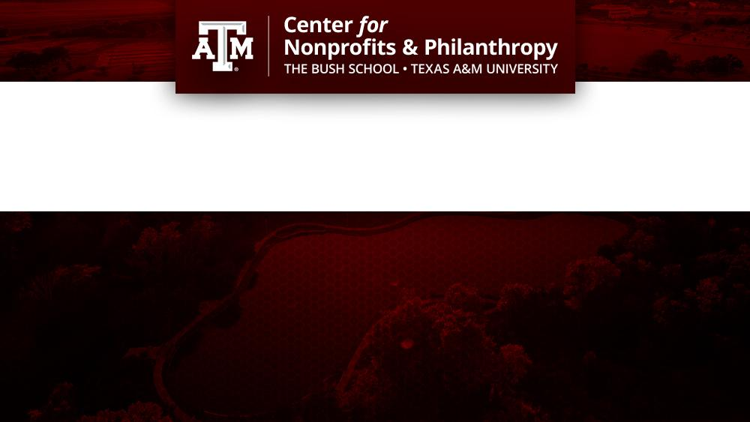
Partnership Principles for University and Nonprofit Collaboration
March 27, 2024
12:00-1:00PM CST
Robbie Waters Robichau, Ph.D.
Associate Professor
Director of the Graduate Certificate Program in Nonprofit Management
Kenneth Anderson Taylor, Ph.D.
Associate Professor of the Practice
Center Director of Outreach & Professional Development

Slide 2
Agenda
About Us
Speaker Introduction
Cross-Sector Collaboration
Importance of University and Nonprofit Partnerships
Successful Components
Individual Leadership Skills
Recent Learnings
Open Discussion

Slide 4
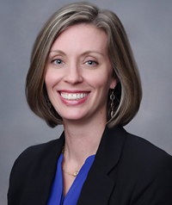
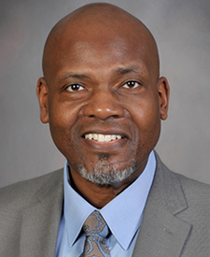
Presenters
Robbie Waters Robichau, Ph.D.
Associate Professor | The Bush School, Texas A&M University
Dr. Robichau’s research examines issues of nonprofit management and accountability, capacity and evaluation, and meaningfulness in public service work. Her work has been published in Nonprofit Management and Leadership, American Review of Public Administration, Policy Studies Journal, Nonprofit Policy Forum, Human Service Organizations: Management, Leadership, and Governance, and various other journals.
Kenneth Anderson Taylor, Ph.D.
Associate Professor of the Practice | The Bush School, Texas A&M University
Dr. Taylor’s primary faculty responsibilities encompass teaching a variety of nonprofit management and
leadership theory courses for graduate students. In his role with the Center for Nonprofits and Philanthropy,
Dr. Taylor enjoys working in Texas and beyond where he gets to utilize his decades of training and partner with
nonprofit leaders on a variety of professional development and research opportunities.

Slide 5
Cross-Sector Collaboration and its Importance
Alliances of individuals and organizations from the nonprofit, government, philanthropic, and business sectors that use their diverse perspectives and resources to jointly solve a societal problem and achieve a shared goal; (SSIR, 2018)
Complexity of today’s challenges
Opportunity to engage multiple stakeholders in solution-based processes
Scaling and sustainability

Slide 6
Why University and Nonprofit Collaboration?
To provide enriched learning opportunities for students
Deepen and enhance the impact of research
Obligation to the communities in which we live, work, and play

Slide 7
Recommendations for Successful Partnerships
Authentic foundation
Building trust
Understanding individual leadership responsibilities
Identifying and realizing mutual benefits
Transparency regarding financial resources
Measuring for success

Slide 8
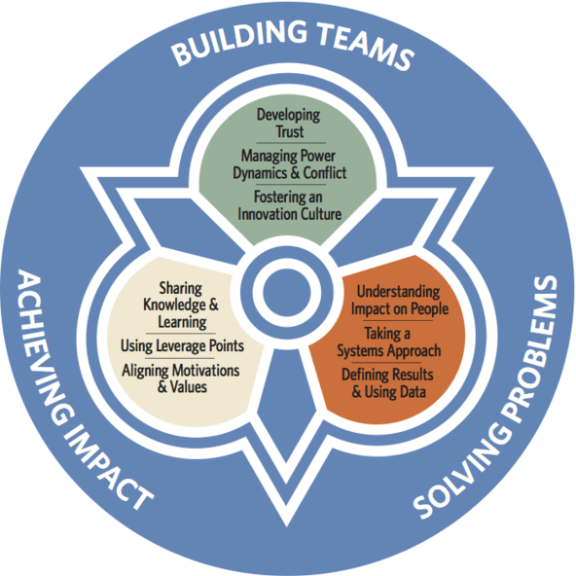
Critical Leader Skills
Trust – relying on one another to accomplish what we can’t on our own
Systems Approach – collective agreement how outcomes are produced
Sharing Knowledge – surety that what is learned is accessible to all stakeholders
(SSIR, 2018)

Slide 9
Recent Takeaways: Nonprofit BRIDGE Conference
Timing
Wide variety when potential partners are available
Funding
Understanding associated costs
Ability to have transparent conversations about money
Willingness to leverage financial resources in partnership
Technology
Embracing the use of and alignment
Skills, on both sides, to understand the technologies in use for projects

Slide 10
Open Discussion
Question and Answer Session

Slide 11
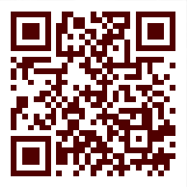
Upcoming Events
April Webinar | Millennial Philanthropy – Engaging the Next Generation of Volunteers and Donors - April 25th
12 - 1 p.m. | Virtual
Continuing & Professional Education Certificates – September 18th
Certificate in Nonprofit Leadership
Certificate in Social Justice Leadership
Certificate in Fundraising Leadership

Slide 12
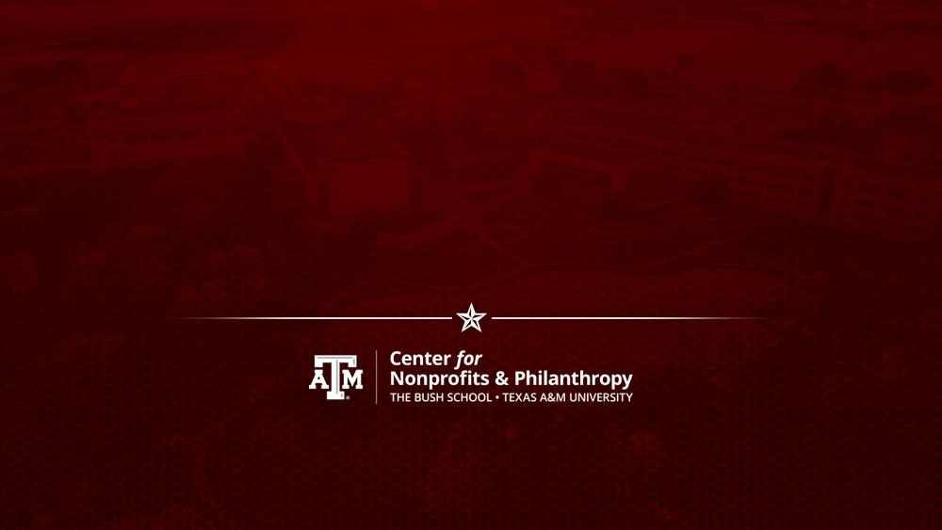
Connect with Us!
@CNPatbushschool
bushschool.nonprofitmanagement@tamu.edu bush.tamu.edu/nonprofit/

