Slide 1
LEADERSHIP OF LOCAL ECONOMIC ENGINES
Women in Texas Chambers of Commerce
Rebecca Nelson
The Bush School of Government

Slide 2
What is the current status of women's inclusion or exclusion on chamber of commerce boards in Texas?

Slide 3
Why Does it Matter?

Slide 4
01. Chamber Prevalence
Texas has the second largest number of chamber of commerce entities in the country
Why Does it Matter?

Slide 5
01. Chamber Prevalence
Texas has the second largest number of chamber of commerce entities in the country
Why Does it Matter?
02. Chamber Influence
Chambers connect public and private sectors as the voice of the business community

Slide 6
01. Chamber Prevalence
Texas has the second largest number of chamber of commerce entities in the country
Why Does it Matter?
02. Chamber Influence
Chambers connect public and private sectors as the voice of the business community
03. Economic Development
Chambers are advocates for local economic development and promote economic growth

Slide 7
S&P 500
Women are often underrepresented in business and excluded from leadership.
30%
14%
Women on the board
Women in leadership roles
2022 U.S. Spencer Stuart Board Index

Slide 8
Texas Chambers
Women are included in equal numbers in both board membership and leadership roles.
56.9%
56.8%
Women on the board
Women in leadership roles

Slide 9
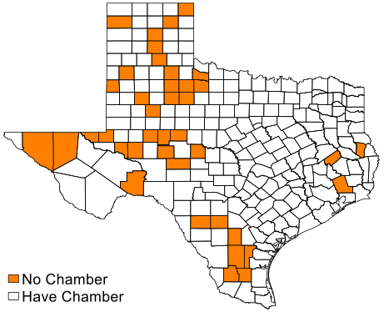
Counties without a Chamber of Commerce
Average population was 7,310 versus 136,614 for the rest of the state
Average population density of 7.1 versus 143.2 rest of state
Higher per capita income $63,032/person versus $54,493 rest of state

Slide 10
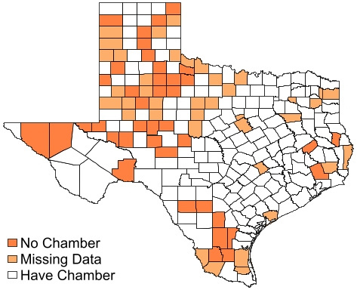
Counties with Missing Data
Average population was 12,782 versus 168,293 for the rest of the state
Average population density of 15.3 versus 175.3 rest of state
Almost identical unemployment rates: 5.58% in counties with data and 5.67% in counties without data

Slide 11
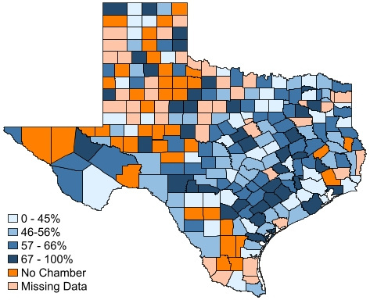
Percent of Women on the Board
Percent of women on the Board varies by county
Community factors do not help us predict concentration of women
Board size can influence concentration of women

Slide 12
Larger boards have fewer women on average
on average 33.9 directors
on average 20.7 directors
on average 17.9 directors
on average 10.8 directors

Slide 13
Findings
Women are equally included on the board of directors and in leadership positions for chambers of commerce in Texas.
Rural counties are less likely to have access to chambers of commerce and the resulting potential benefits.
Despite their prevalence in Texas, little research has been done on chambers of commerce.

Slide 14
Lessons for Texas Leaders

Slide 15
CHAMBERS AS A RESOURCE.
An excellent opportunity for women to build leadership experience and relationships in order to expand their overall impact.

Slide 16
UNDERSTAND YOUR COMMUNITY.
Data is not just for research. Tracking leadership and using community data allows you to consider what you may be missing.

Slide 17
ROOM FOR GROWTH.
Many communities do not have access to chambers. Others have limited activity. Communication improvements and increased research are needed.

Slide 18
For More Information
Rebecca Nelson
nelsonrebeccap@gmail.com

