Slide 1
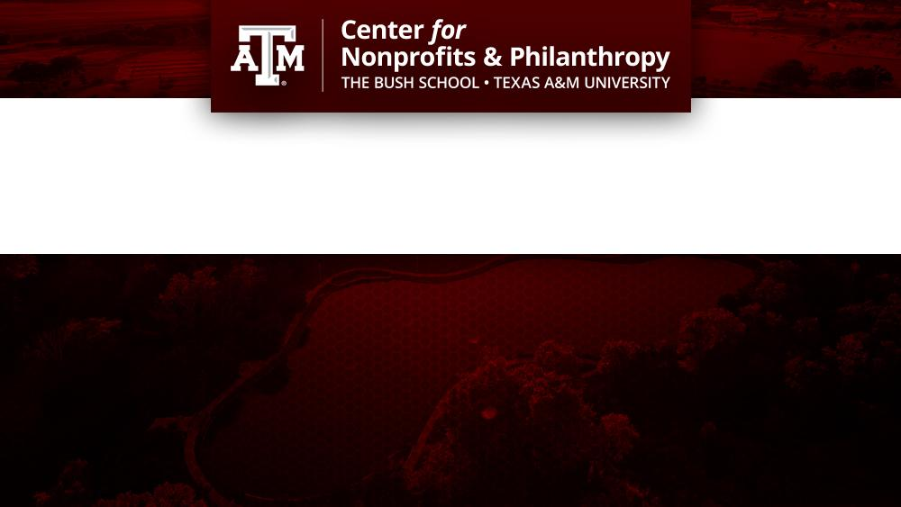
Individual and Organizational Dimensions of Volunteerism at Public Service Organizations
October 11, 2023
12:00-1:00PM CST
Rachel Currie Triska
Chief Executive Officer (CEO)
VolunteerNow
Kenneth Anderson Taylor, Ph.D.
Center Director of Outreach & Professional Development
The Bush School at Texas A&M University

Slide 2
Agenda
Welcome and About Us
Introduction of Guest Speaker
Opening
U.S. Census Bureau and AmeriCorps Survey Highlights
Solutions to Increase Volunteerism
Dimensions of Volunteerism
Individual
Organizational
Takeaways
On-the-Ground Best Practices
Open Discussion

Slide 4
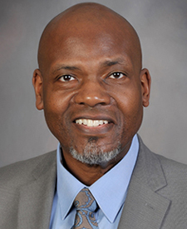
Presenters
Rachel Currie Triska
Chief Executive Officer (CEO) | VolunteerNow
Rachel Currie Triska is a passionate, forward-thinking leader who finds joy in listening to and building consensus with
diverse partners. Well known for her advocacy in areas of justice and equity, Rachel was recently named Champion
for the Human Rights Initiative of North Texas. In 2023, she became CEO of VolunteerNow, one of the largest Volunteer
Centers in the Country.
Kenneth Anderson Taylor, Ph.D.
Center Director of Outreach & Professional Development | The Bush School, Texas A&M University
Dr. Taylor’s primary faculty responsibilities encompass teaching a variety of nonprofit management and
leadership theory courses for graduate students. In his role with the Center for Nonprofits and Philanthropy,
Dr. Taylor enjoys working in Texas and beyond where he gets to utilize his decades of training and partner with
nonprofit leaders on a variety of professional development and research opportunities.

Slide 5
Guest

Slide 6
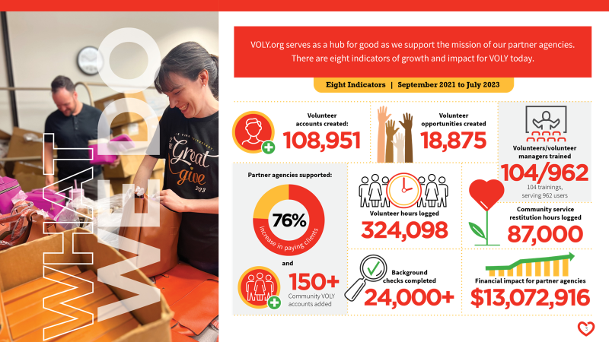

Slide 7
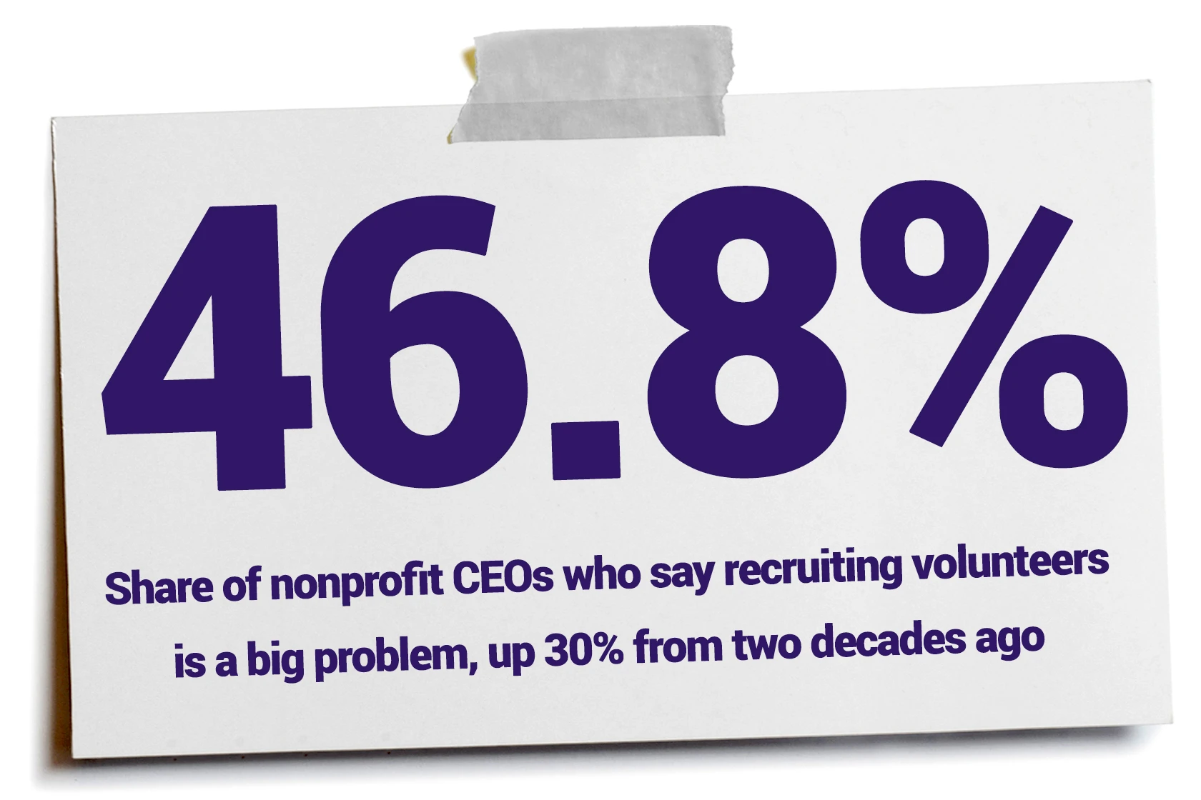
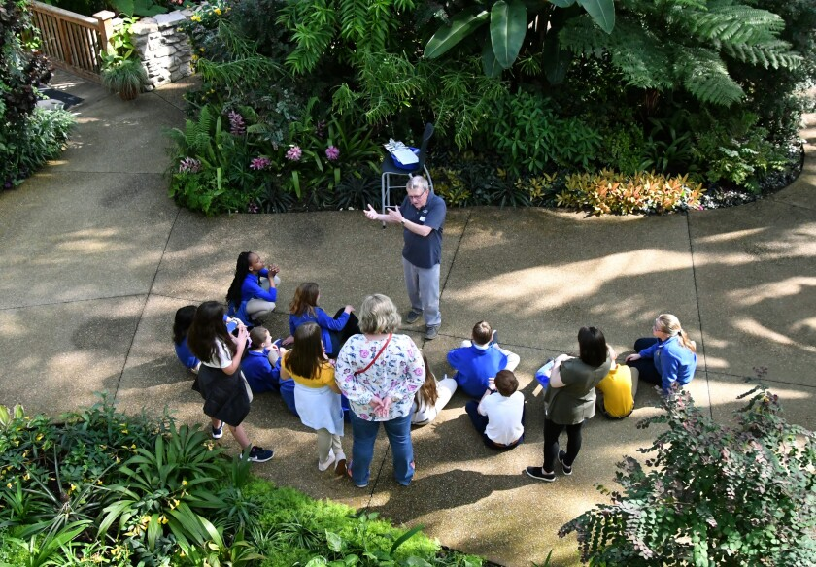
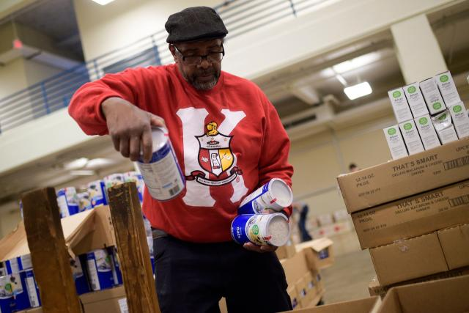
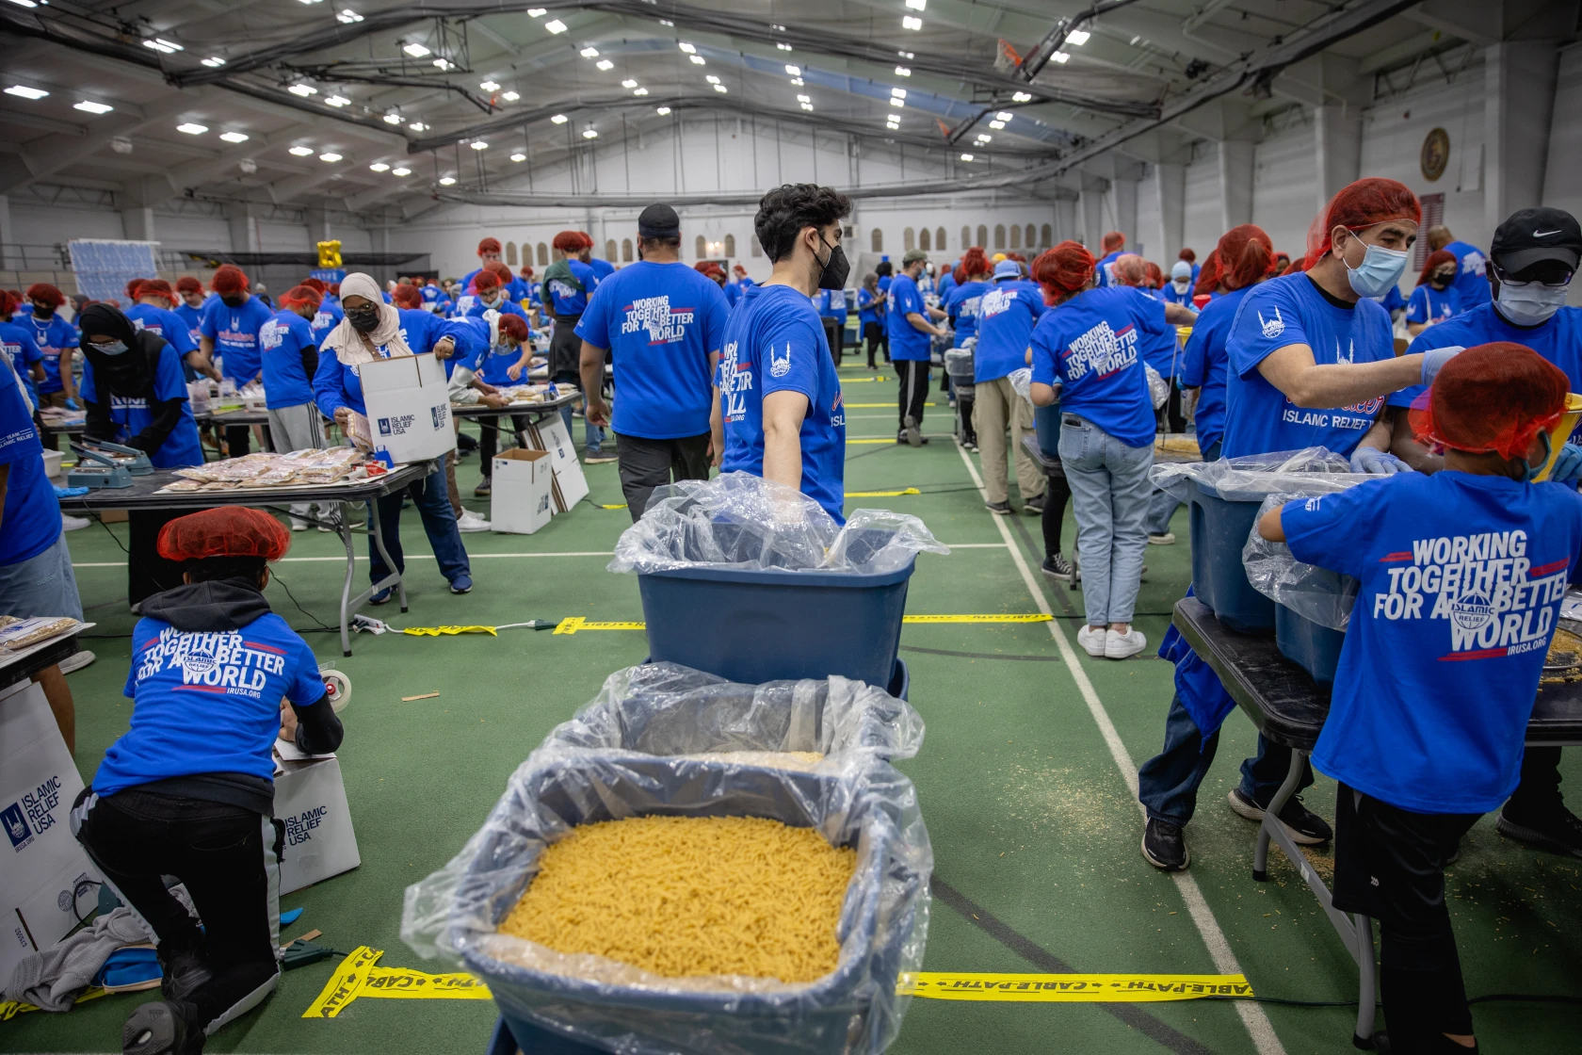
Agenda
(The Chronicle of Philanthropy, 2023)

Slide 8
U.S. Census Bureau and AmeriCorps Survey, 2023
23.2% of all respondents engaged in formal volunteer participation
Represents the largest decrease the survey has recorded since 2002
7% decrease percentage points between 2019 and 2021

Slide 9
Potential Solutions?
Increased transparency with volunteers; required skills and length of commitment
Volunteering should be fun, entertaining, ability to do with friends; so that it’s memorable
Utilize volunteers from the communities you serve in
Employ an efficient process for saying yes to volunteers and in getting them started on the task(s)
Bottom-up approach
Utilize apps to connect volunteers with service opportunities

Slide 10
Dimensions of Volunteerism
Individual
Organizational
Volunteer entry into and exit from the organization
Volunteers’ characteristics and diversity
Intensity and duration of commitment
Volunteers’ work quality
Decision to use volunteers
Magnitude of volunteer use
Volunteer contributions to the organization
Status of volunteers

Slide 11
Individual Dimensions
Entry into and exit, volunteer diversity, intensity/duration of commitment, work quality of others
The decision to start or stop volunteering and turnover
Demographics (age, gender, race/culture) and motivations
Hours one has to donate and if episodic/short versus long/number of events/days-weeks-etc
Accuracy of work, speed and timeliness, reliability, and absenteeism

Slide 12
Organizational Dimensions
Use of volunteers, magnitude of volunteer use, volunteer contributions, and status of volunteers
Whether or not to use volunteers and the type of volunteers sought; age, background, education
How many needed, manageable number of hours, and the number of certain types of volunteers
Volunteers’ tasks and roles, interchangeability of staff and volunteers, and if vital to mission
Degree of integration, degree of marginalization, and volunteer status relative to staff status

Slide 13
Takeaways
The Limits and Possibilities of Volunteering…
Similar to a variety of leadership constructs, remember that individuals who donate their time and organizations who need volunteers is a double-sided relationship
Racial and cultural diversity matters
Keep in mind how your actions and behaviors contribute to, or take away from heightening overall formal volunteerism
(Nesbit et al., 2018)

Slide 14
On-the-Ground Best Practices
The Pareto Principle Applies with Volunteers
Use the RFI Model (Recency, Frequency, Impact) to identify your top 20%
Invest in developing those volunteers
Form Volunteers as Much as You Train Them
Vision of “The Good Life” includes volunteerism
Volunteer Journey (Reflect & Shape What Matters to Us)
Think in terms of “Communal Practices”
Try a Human Centered Design Approach to Engagement Strategy
Empathize, Define, Ideate, Prototype, Test (Evaluate & Repeat)
Bi-directional Design & Benefit (Those Serving and Those Being Served)
“We are what we love, and our love is shaped, primed, and aimed by practices that take hold of our gut and aim our heart to certain ends.”

Slide 15
Open Discussion
Question and Answer Session

Slide 16
Upcoming Events
November Webinar - November 8th | Anatomy of a Nonprofit Brand
12 - 1 p.m. | Virtual
Leadership in Board Service - November 8th
4 - 7 p.m. | College Station - APCC
Leadership in Board Service - January 9th
1 - 4 p.m. | Houston - United Way Building
Continuing & Professional Education Certificates - February 7th

Slide 17
Connect with Us!
@CNPatbushschool
bushschool.nonprofitmanagement@tamu.edu

